Slide 1



Slide 2

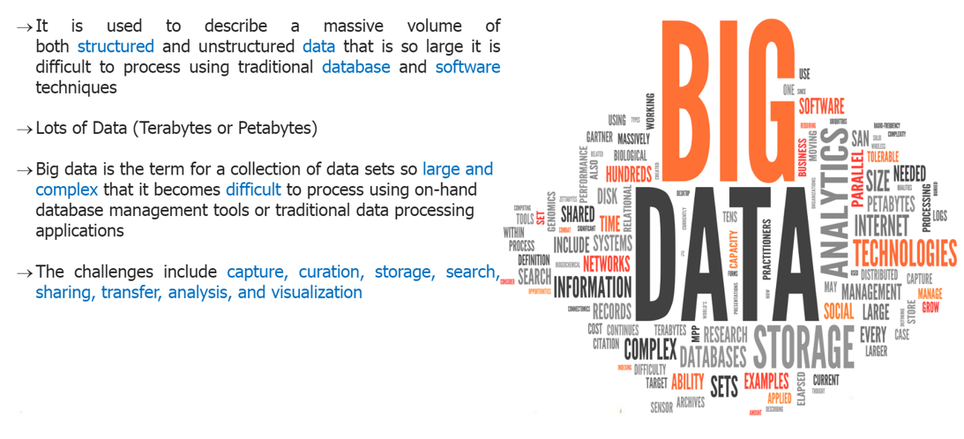
What is Big Data

Slide 3
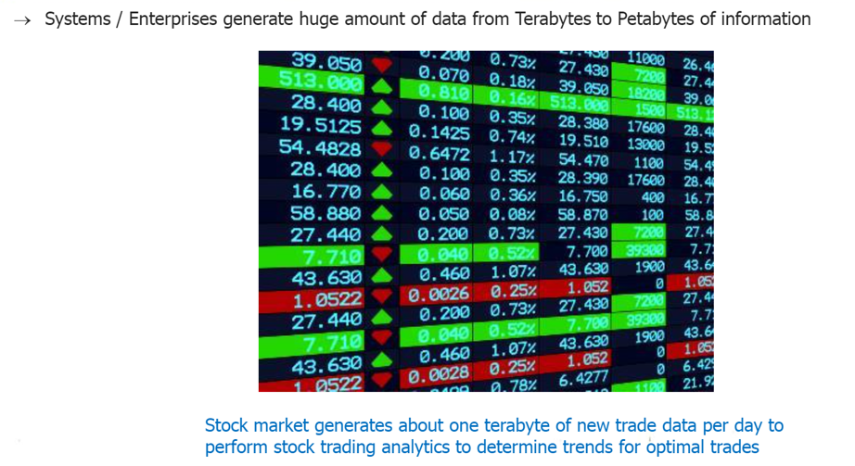
What is Big Data

Slide 4
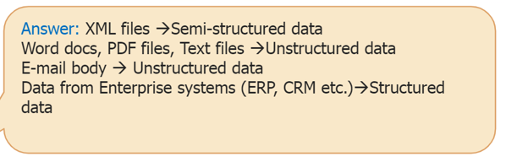
What is Big Data

Slide 5
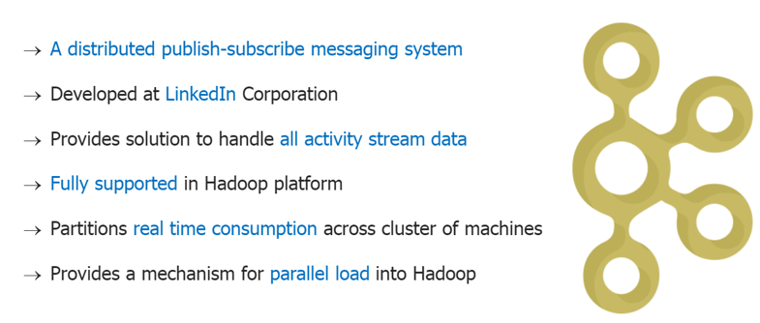
What is Kafka ?

Slide 6
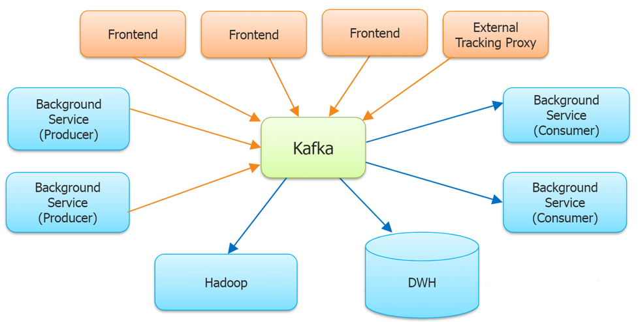
Apache Kafka - Overview

Slide 7
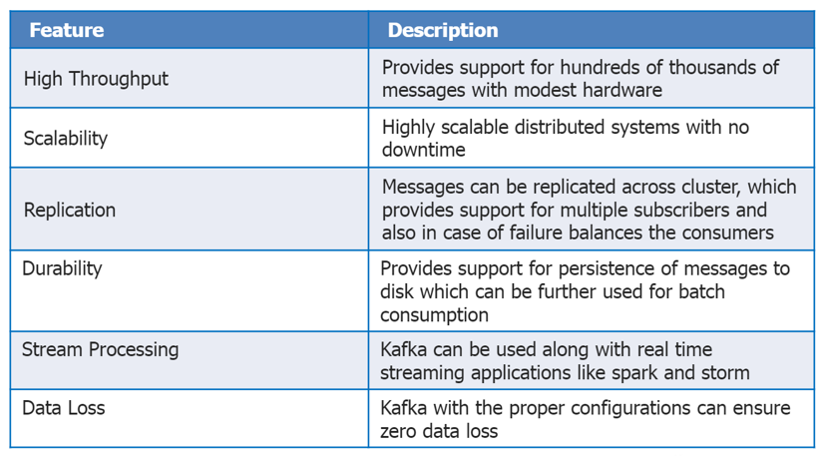
Apache Kafka - Need

Slide 8
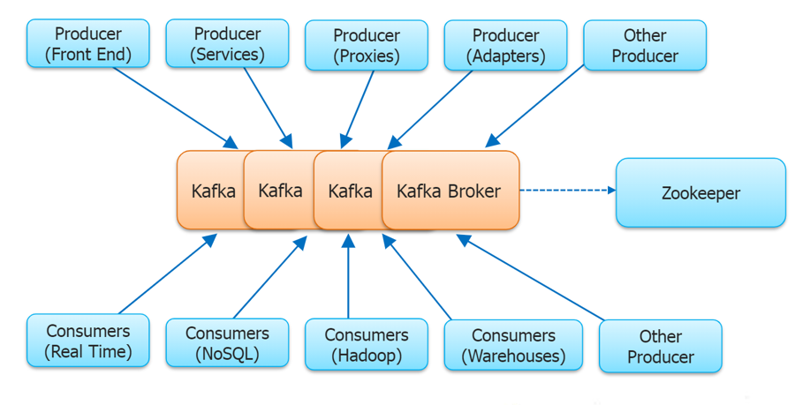
Apache Kafka - Architecture

Slide 9
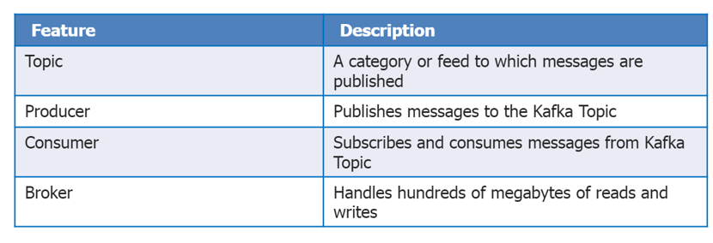
Apache Kafka – Core Concepts

Slide 10
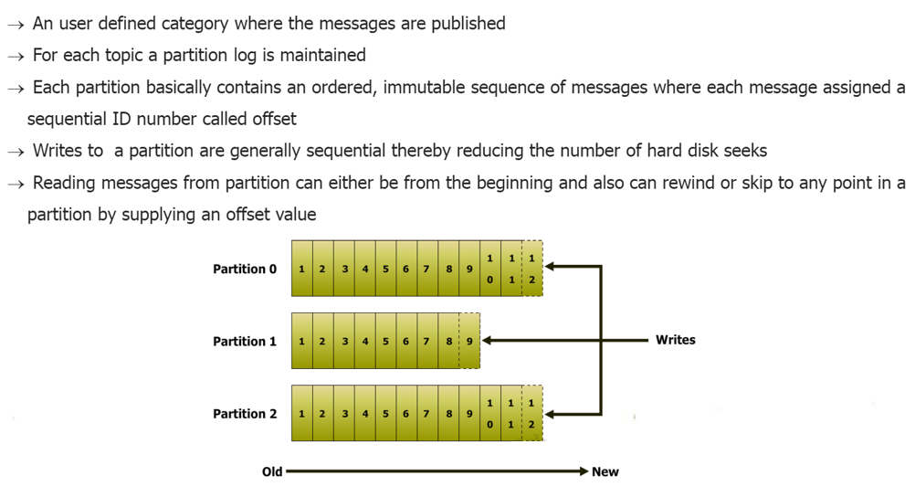
Kafka Topic

Slide 11
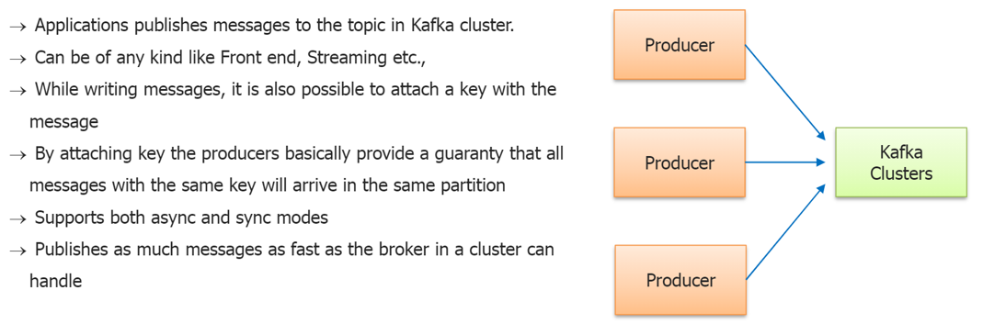
Kafka Producers

Slide 12
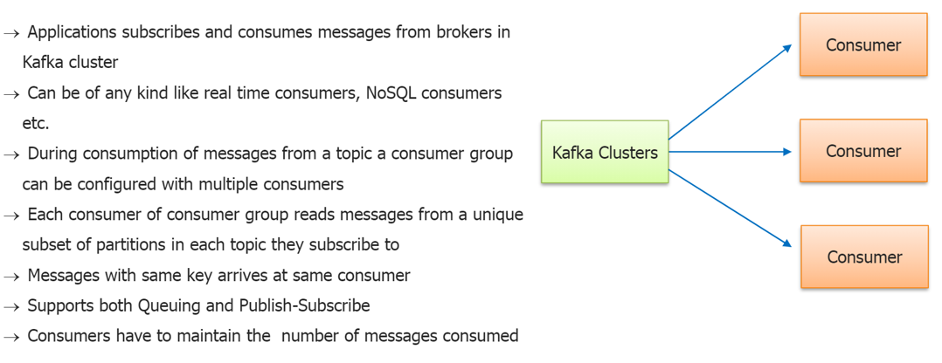
Kafka Consumers

Slide 13
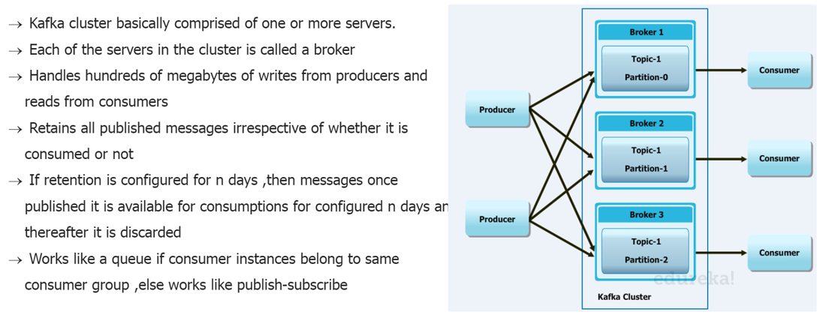
Kafka Brokers

Slide 14
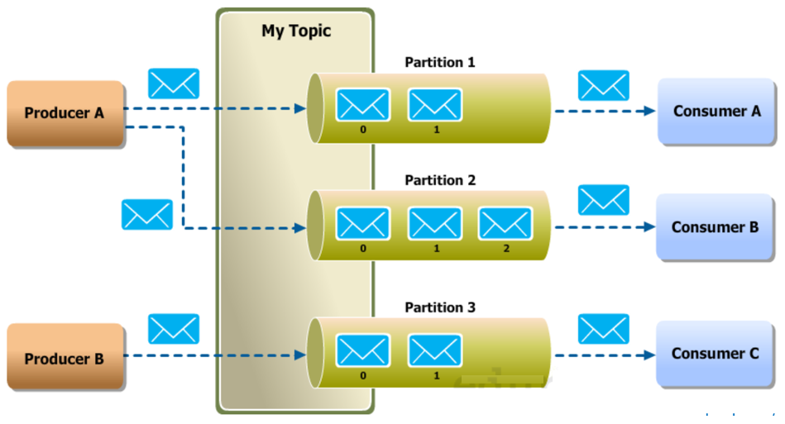
Kafka Producer – Broker - Consumer

Slide 15
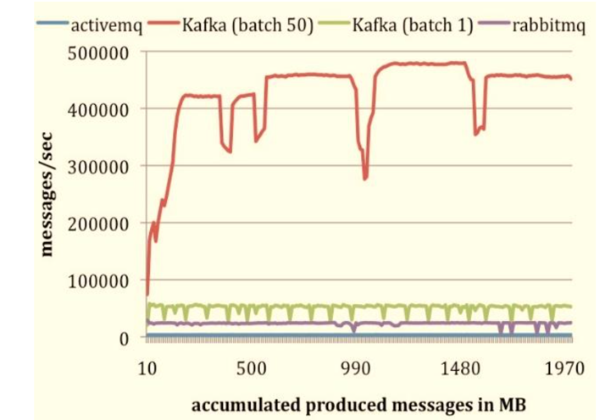
Kafka Producer Performance with Other Systems

Slide 16
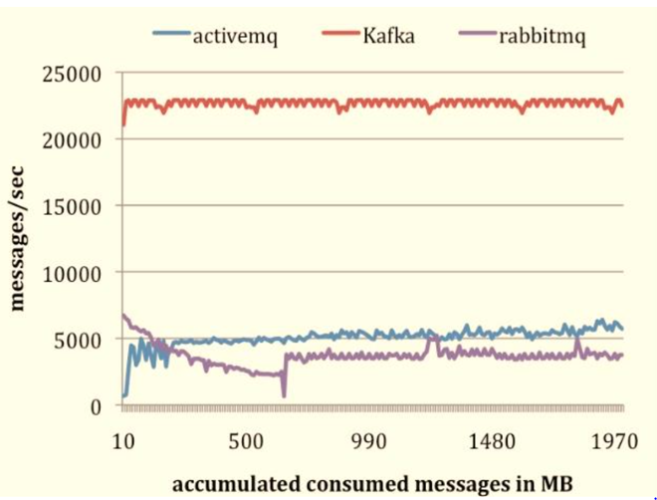
Kafka Consumer Performance with Other Systems

